Slide 1


PYTHON DATA ANALYSIS REPORT
Name : Ajwani Vanshika
Course : B.Sc. CS-IT
Date : 27.12.2025

Slide 2

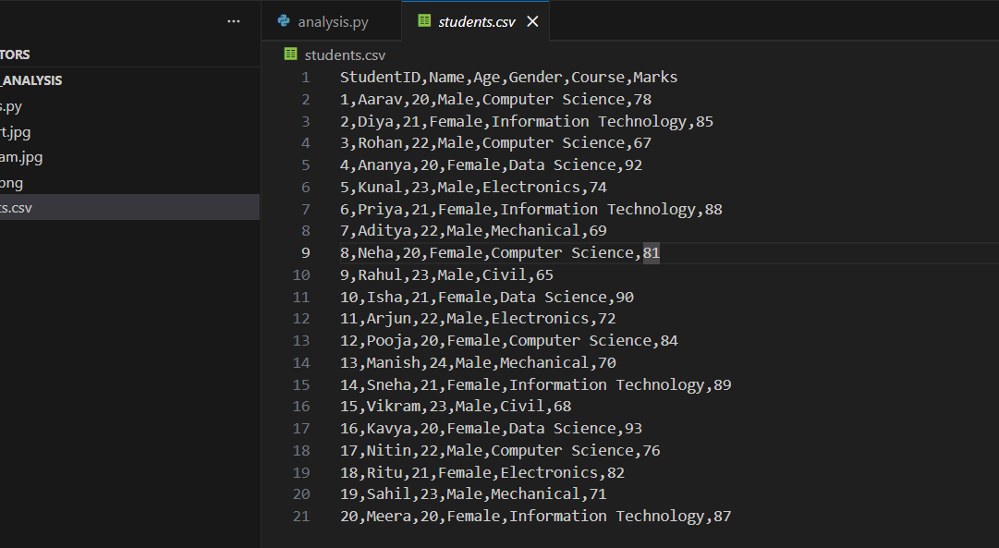
DATASET OVERVIEW
Number of Records : 20 students
Columns Used:
StudentID
Name
Age
Gender
Course
Marks
Purpose of Dataset:
To analyze student performance across different
courses using Python.

Slide 3
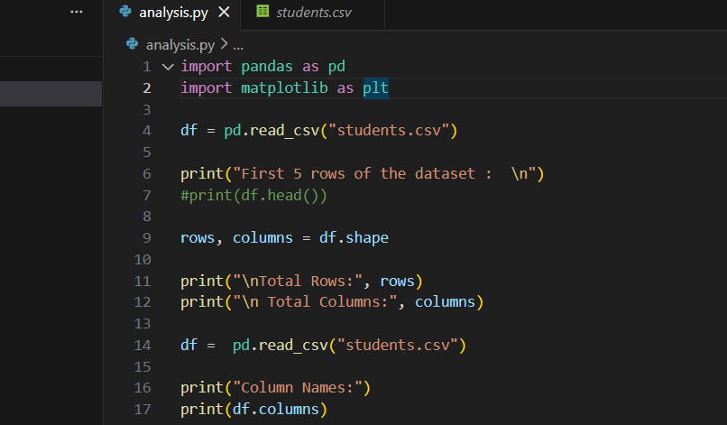
DATA CLEANING
Missing Values Found:
No missing values detected in the dataset
Data Cleaning Steps:
Dataset was checked using pandas functions
No rows or columns were removed as data was complete.

Slide 4
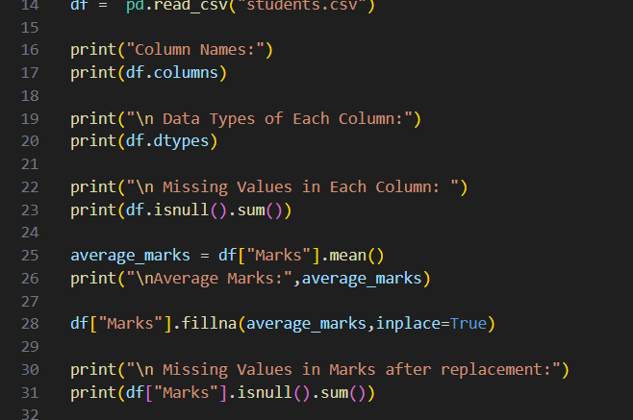
Analysis insights
Average Marks by Courses :
Python : High overall performance
Data Science : Consistent scores
Web Development : Moderate Performance
Machine Learning : Highest Average marks

Slide 5
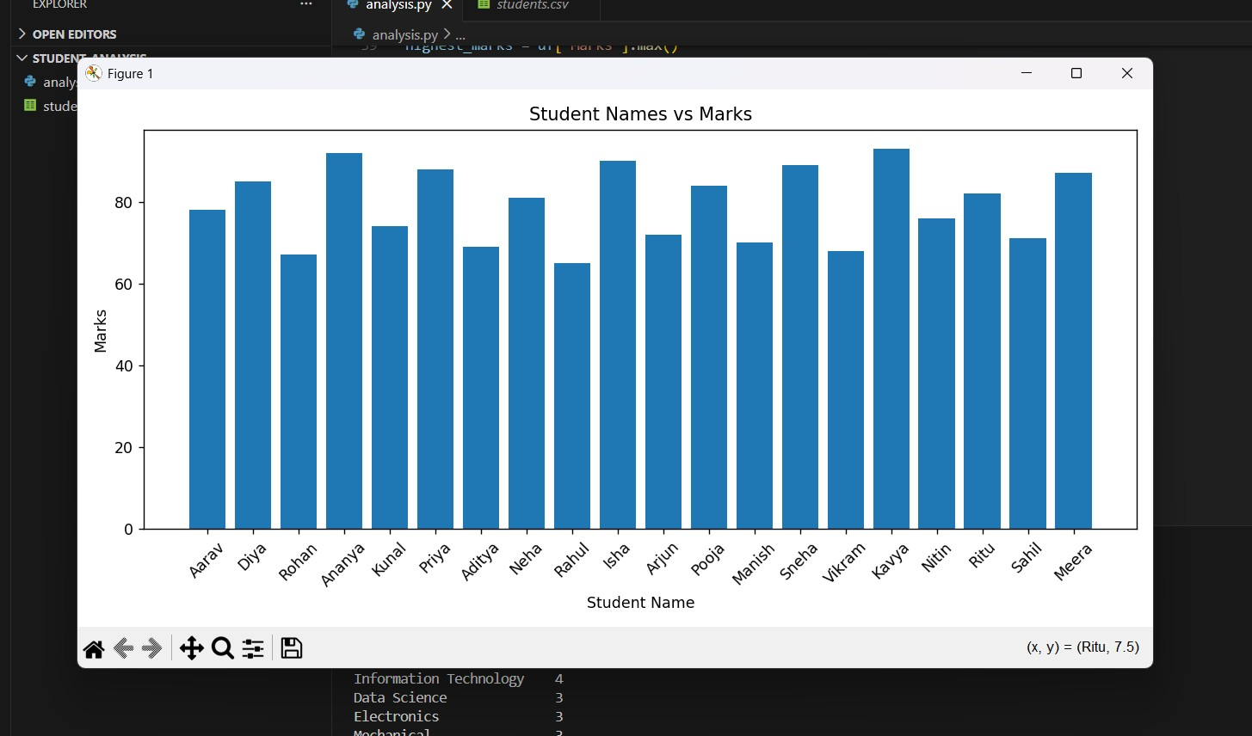
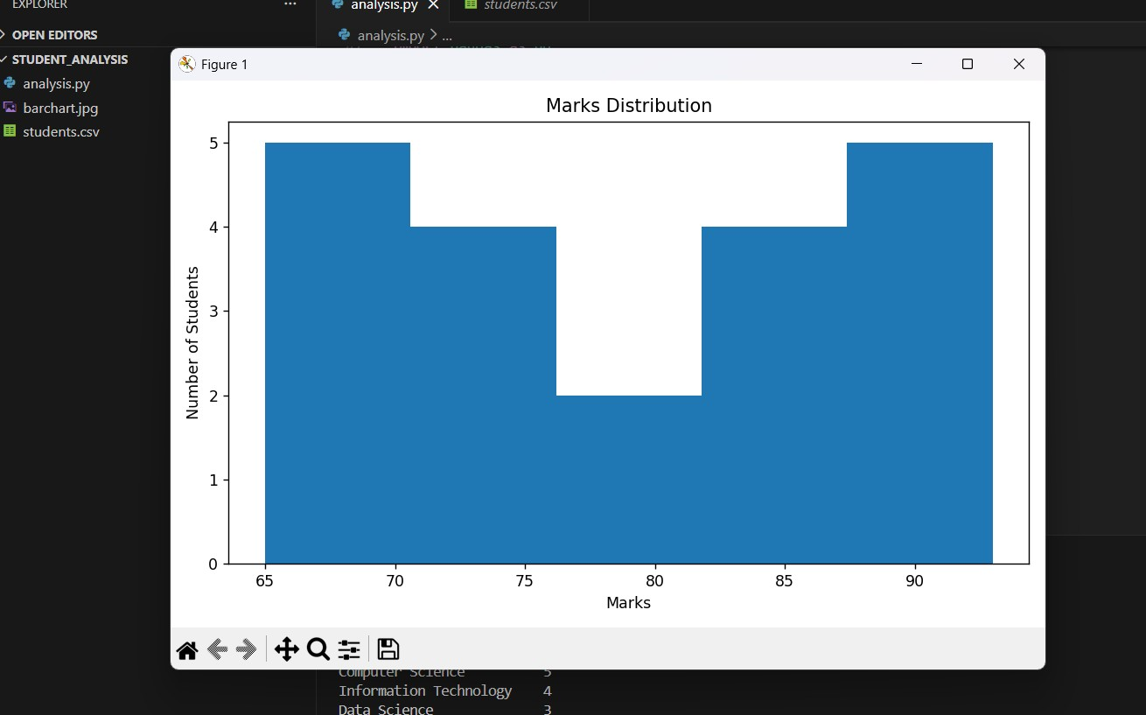
VISUALIZATIONS
Bar Chart:
Shows student-wise marks distribution.
Histogram:
Displays overall marks distribution.
Visualization help understand:
Performance trends.
score frequency and spread.

Slide 6
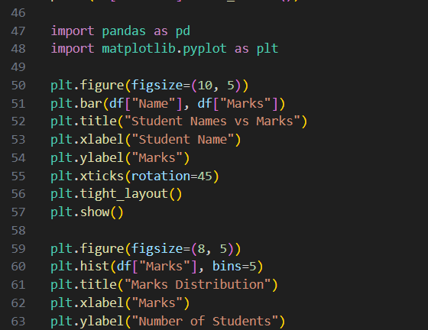
Conclusion
Learned how to load, clean, analyze, and visualize data using python.
Gained hands-on experience with pandas and matplotlib.

